Slide 1
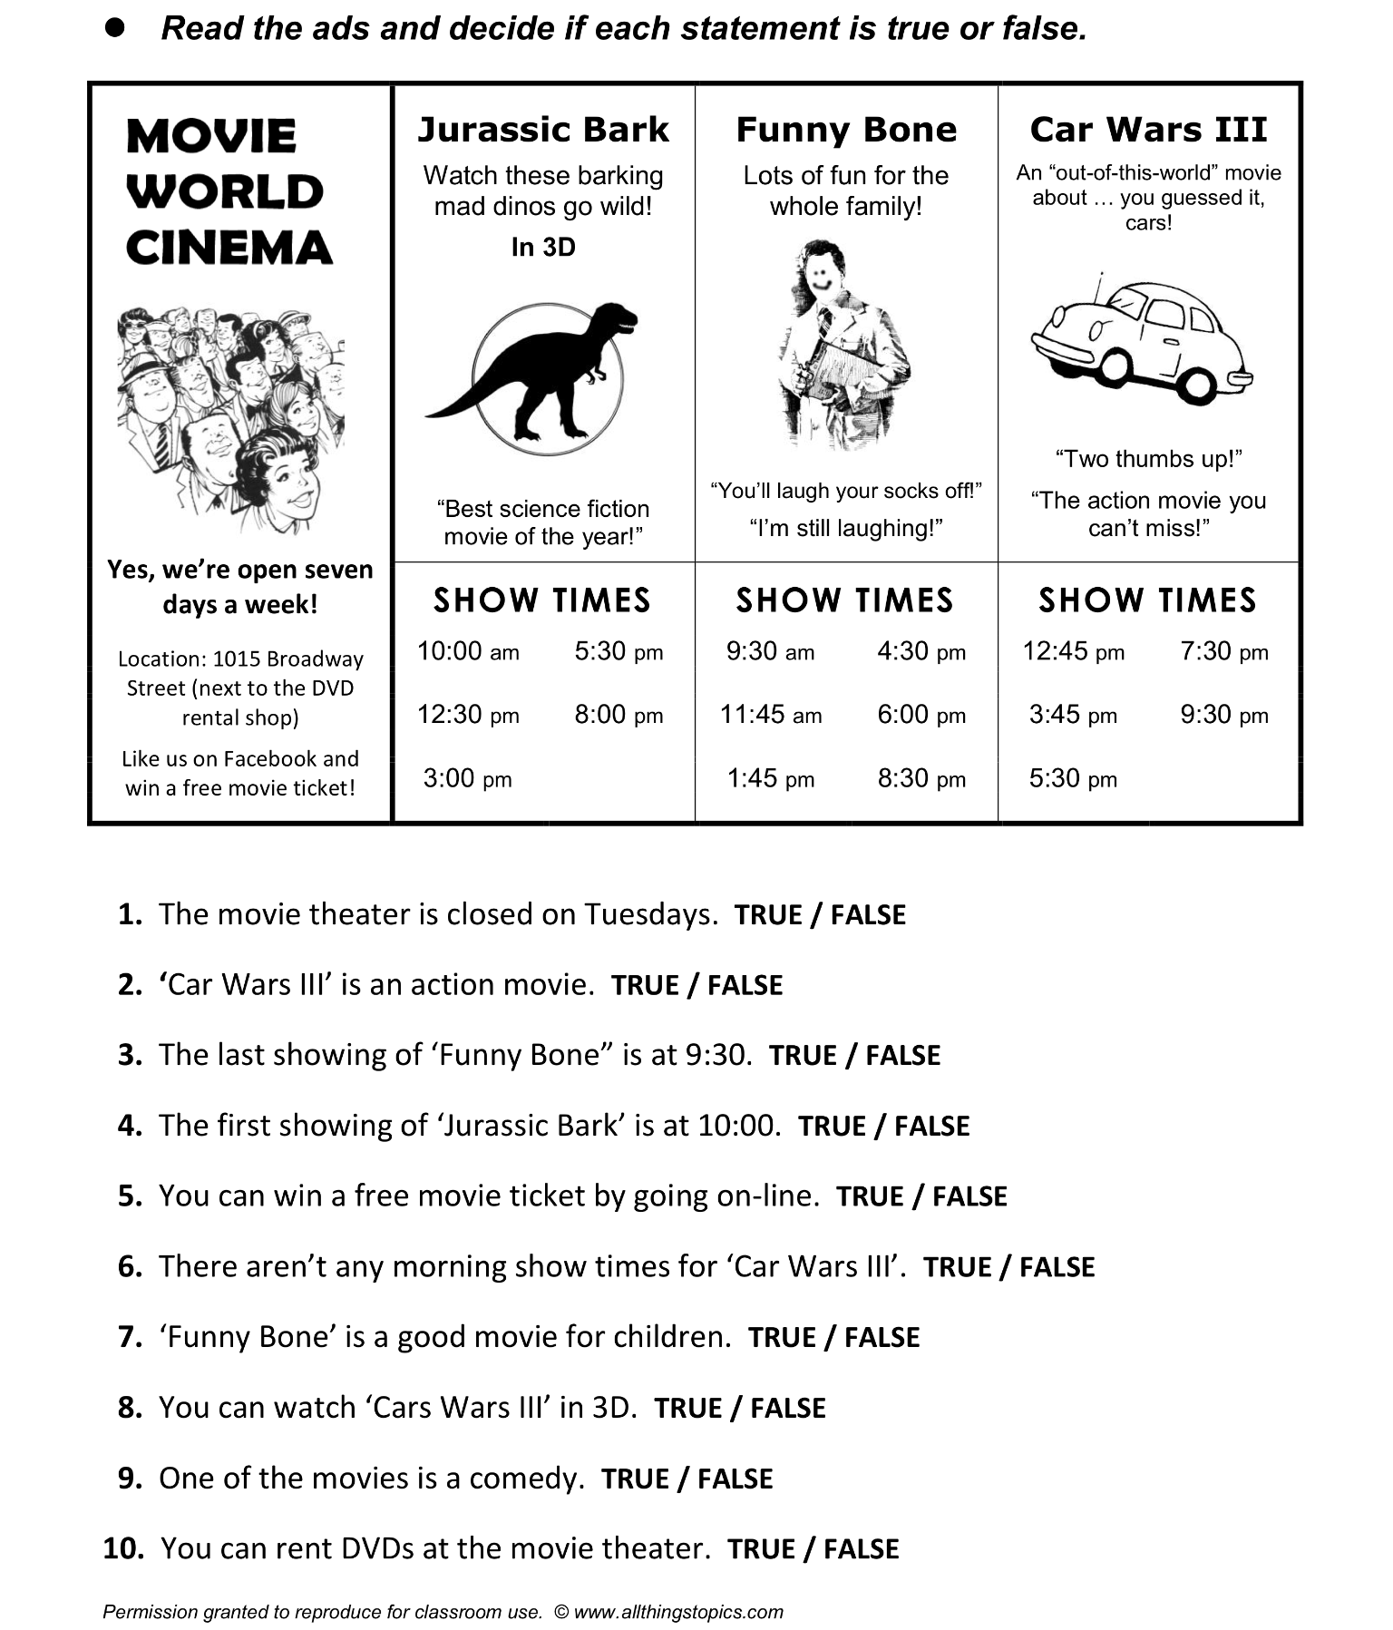

Slide 2



SKILLS AND STRATEGIES

Slide 3

READING STRATEGIES
READING STRATEGY IS A TECHNIQUE TO HELP YOU ACTIVELY READ THE LITERATURE BEING STUDIED.

Slide 4


TYPES OF STRATEGIES:
SKIMMING
SCANNING
INTENSIVE READING
.
EXTENSIVE READING

Slide 5
Skimming
Sometimes referred to as gist reading, means going through the text to grasp the main idea.
ex:
Reading magazines or newspapers and searching for a
name in a telephone directory.
Scanning
The reader quickly scuttles across sentences to get to a particular piece of information.
Scanning involves the technique of rejecting or ignoring irrelevant information from the text to locate a specific piece of information.

Slide 6
Scanning Activity
1. How many from the senatorial bets answered ‘no’ in the question “Do you think the Philippine Government was effective in its response to the COVID-19?”
2. What are the key issues asked during the yes or no segment? Give five.
3. How many were wounded and what did De Guzman saw on his arrival at the Ninoy Aquino International Airport?
4. What had Joshua Ravelo, a firstyear Information Technology student shared in an interview about what steps he had to take as he faced Typhoon Odette’s aftermath?
5. Tell me how Joss Ecleo, a Computer Science freshman dealt with his student responsibilities after the super typhoon damaged his house.

Slide 7
Scanning Activity
6. Who amongst the senatorial bets answered ‘yes’ in the question “Pabor ka bang ibalik and Death Penalty?”
7. Who amongst the senatorial bets answered ‘yes’ in the question “Are you in favor of legalizing abortion?”
8. How many senatorial candidates initially confirmed their attendance to The Rundowm 2022?
9. How many senatorial candidates were able to officially attend The Rundown 2022?
10. Who did De Guzman think was the target in the shooting?

Slide 8
Seatwork
From the story The Lady or The Tiger, 1. The word “King” appeared 16 times, underline them all in black. (5pts) 2. The word “barbaric” appeared 3 times, highlight them all in red. (5pts) 3. The word “youth” appeared 18 times, highlight them all in light yellow. (5pts) 4. How many times the word “subjects” appeared in the story? Encode the answer in the bottom of your copy of the story. (5pts) 5. Look for unfamiliar words. Give at least 10 and encode them in bullets in the bottom of your copy of the story. (10 pts)
Give me the main gist of the story. It should be short but complete. (20pts)

Slide 9
Assignment
Instructions:
Skim and Scan the “The Cat Who Saved The Books” and answer the ff:
The word “Rintaro” appeared how many times? (20pts)
The word “grandfather” appeared how many times? (20 pts)
What is Rintaro’s grandfather’s mantra? (2pts)
Who was the male customer in the first 6 pages of the story? (2pts)
What is the name of the tiny bookshop? (2pts)
Look for The Third Labyrinth: The Seller of Books chapter, state the first word of the chapter. (2pts)
What is Rintaro’s grandfather’s favorite flower? (2pts)

